Slide 1
Black Hole Astrophysics Chapters 9.2.2&9.4
All figures extracted from online sources of from the textbook.

Slide 2
Laws of Conservation of Charge and Current (Ch9.2.2)

Slide 3
Conservation of Charge
Very much mass density, the charge density is the sum of all species.
$$ρ_{q}≡\underset{i}{Σ}⁢n_{i}⁢q_{i}$$
However, in this case, it can be zero everywhere in the plasma.
From the continuity equation in classical physics $\frac{∂ρ_{q}}{∂t}+\overset{⇀}{∇}·\overset{⇀}{J}=0$, we can very easily translate that to $∇_{α}J^{α}=0$.
This equation enables us to determine only $ρ_{q}$, therefore we will later introduce the Generalized Ohm’s law to find the $\overset{⇀}{J}$ part.
*Note：
I sort of find it confusing to have all these 3-vectors and 4-vectos together in 1 slide, so to avoid having to label which is a 3-vector and which is a 4-vector, I chose to put vector/tensor symbols only for 3-vectors and all 4-vectors will be written in component form.

Slide 4
Conservation of Charge
Without loss of generality, we can separate the 4-current into
$$J^{α}=ρ_{q}⁢U^{α}+𝔍^{α}$$
Containing a component parallel to U and another perpendicular to it.
Therefore, $𝔍^{α}≡P^{αβ}⁢J_{β}$
And it automatically satisfies $U^{α}⁢𝔍_{α}=0$ as we derived last week for the projection tensor.

Slide 5
Recap for Plasma Astrophysics
Recall that we had defined the velocity of a fluid element as $\overset{⇀}{v}=\frac{m_{e}⁢n_{e}⁢{\overset{⇀}{v}}_{e}+m_{i}⁢n_{i}⁢{\overset{⇀}{v}}_{i}}{ρ_{m}}≈{\overset{⇀}{v}}_{i}$, this is due to the fact that momentum is dominated by protons and therefore the center of momentum velocity can be approximated by the proton velocity.
Next, the current is defined as $\overset{⇀}{J}=q_{e}⁢n_{e}⁢{\overset{⇀}{v}}_{e}+q_{i}⁢n_{i}⁢{\overset{⇀}{v}}_{i}≈q_{e}⁢n_{e}⁢\left({\overset{⇀}{v}}_{e}−{\overset{⇀}{v}}_{i}\right)$. The interesting thing to observe here is that given not too much of a density difference between the protons and electrons, the current becomes proportional to the difference of velocities $⁢\left({\overset{⇀}{v}}_{e}−{\overset{⇀}{v}}_{i}\right)$.
A useful (at least I find it useful…) way of thinking of this is that current, $\overset{⇀}{J}$ is caused motion of electrons with respect to the c.m. velocity (which is ${\overset{⇀}{v}}_{i}$) of the fluid elements.
Thus,
fluid element motion is driven by protons
current is mainly caused by electrons.
Using these two simple concepts we can understand the Generalized Ohm’s law quite simply.

Slide 6
The generalized Ohm’s law – Review
The generalized Ohm’s law reads as :
$$\frac{∂\overset{⇀}{J}}{∂t}=−\frac{q_{e}}{m_{e}}⁢\overset{⇀}{∇}·{\overset{⟷}{P}}_{e}+\frac{n_{e}⁢{q_{e}}^{2}}{m_{e}}⁢\left(\overset{⇀}{E}+\overset{⇀}{v}×\overset{⇀}{B}\right)+\frac{q_{e}}{m_{e}}⁢\left(\overset{⇀}{J}×\overset{⇀}{B}\right)−\frac{n_{e}⁢{q_{e}}^{2}}{m_{e}}⁢\hat{η}·\overset{⇀}{J}$$
In simple language, it simply says:
What are the different ways we can cause the current to change? $\left(\frac{∂\overset{⇀}{J}}{∂t}\right)=…$
1. The Pressure gradient term $\left(−\frac{q_{e}}{m_{e}}⁢\overset{⇀}{∇}·{\overset{⟷}{P}}_{e}\right)$
As we just explained, current is caused by velocity difference between $e^{−}\&⁢p^{+}$, however, if the pressure on $e^{−}\&⁢p^{+}$ are similar, $⁢p^{+}$, being heavier, is harder to push.
Thus, mostly it’s only the electrons being accelerated.
$\overset{⇀}{J}$(t)
$q_{e}⁢n_{e}$ omitted for all figures
${\overset{⇀}{v}}_{e}$(t)
${\overset{⇀}{v}}_{i}$(t)~ ${\overset{⇀}{v}}_{i}$(t+dt)
$\overset{⇀}{J}$(t+dt)
${\overset{⇀}{v}}_{e}$(t+dt)
${\overset{⇀}{v}}_{i}$(t)~ ${\overset{⇀}{v}}_{i}$(t+dt)

Slide 7
The generalized Ohm’s law – Review
The generalized Ohm’s law reads as :
$$\frac{∂\overset{⇀}{J}}{∂t}=−\frac{q_{e}}{m_{e}}⁢\overset{⇀}{∇}·{\overset{⟷}{P}}_{e}+\frac{n_{e}⁢{q_{e}}^{2}}{m_{e}}⁢\left(\overset{⇀}{E}+\overset{⇀}{v}×\overset{⇀}{B}\right)+\frac{q_{e}}{m_{e}}⁢\left(\overset{⇀}{J}×\overset{⇀}{B}\right)−\frac{n_{e}⁢{q_{e}}^{2}}{m_{e}}⁢\hat{η}·\overset{⇀}{J}$$
In simple language, it simply says:
What are the different ways we can cause the current to change? $\left(\frac{∂\overset{⇀}{J}}{∂t}\right)=…$
2. The collision term $\left(−\frac{n_{e}⁢{q_{e}}^{2}}{m_{e}}⁢\hat{η}·\overset{⇀}{J}\right)$
Again, similar to the pressure gradient term, forces mainly affect the velocity of electrons.
$\overset{⇀}{J}$(t)
${\overset{⇀}{v}}_{e}$(t)
${\overset{⇀}{v}}_{i}$(t)~ ${\overset{⇀}{v}}_{i}$(t+dt)
$\overset{⇀}{J}$(t+dt)
${\overset{⇀}{v}}_{e}$(t+dt)
${\overset{⇀}{v}}_{i}$(t)~ ${\overset{⇀}{v}}_{i}$(t+dt)

Slide 8
The generalized Ohm’s law – Review
The generalized Ohm’s law reads as :
$$\frac{∂\overset{⇀}{J}}{∂t}=−\frac{q_{e}}{m_{e}}⁢\overset{⇀}{∇}·{\overset{⟷}{P}}_{e}+\frac{n_{e}⁢{q_{e}}^{2}}{m_{e}}⁢\left(\overset{⇀}{E}+\overset{⇀}{v}×\overset{⇀}{B}\right)+\frac{q_{e}}{m_{e}}⁢\left(\overset{⇀}{J}×\overset{⇀}{B}\right)−\frac{n_{e}⁢{q_{e}}^{2}}{m_{e}}⁢\hat{η}·\overset{⇀}{J}$$
In simple language, it simply says:
What are the different ways we can cause the current to change? $\left(\frac{∂\overset{⇀}{J}}{∂t}\right)=…$
3. The Electric field term $\left(\frac{n_{e}⁢{q_{e}}^{2}}{m_{e}}⁢\overset{⇀}{E}\right)$
This again is because that a given electric field will mainly accelerate electrons.
$\overset{⇀}{J}$(t)
${\overset{⇀}{v}}_{e}$(t)
${\overset{⇀}{v}}_{i}$(t)~ ${\overset{⇀}{v}}_{i}$(t+dt)
$\overset{⇀}{J}$(t+dt)
${\overset{⇀}{v}}_{e}$(t+dt)
${\overset{⇀}{v}}_{i}$(t)~ ${\overset{⇀}{v}}_{i}$(t+dt)

Slide 9
The generalized Ohm’s law – Review
The generalized Ohm’s law reads as :
$$\frac{∂\overset{⇀}{J}}{∂t}=−\frac{q_{e}}{m_{e}}⁢\overset{⇀}{∇}·{\overset{⟷}{P}}_{e}+\frac{n_{e}⁢{q_{e}}^{2}}{m_{e}}⁢\left(\overset{⇀}{E}+\overset{⇀}{v}×\overset{⇀}{B}\right)+\frac{q_{e}}{m_{e}}⁢\left(\overset{⇀}{J}×\overset{⇀}{B}\right)−\frac{n_{e}⁢{q_{e}}^{2}}{m_{e}}⁢\hat{η}·\overset{⇀}{J}$$
In simple language, it simply says:
What are the different ways we can cause the current to change? $\left(\frac{∂\overset{⇀}{J}}{∂t}\right)=…$
4. The plasma motion term $\left(\frac{n_{e}⁢{q_{e}}^{2}}{m_{e}}\overset{⇀}{v}×\overset{⇀}{B}\right)$
As we mentioned earlier, the plasma bulk velocity mainly follows that of protons, thus this term tells us the change in current due to protons deflected by B field.
$$\overset{⇀}{B}$$
$\overset{⇀}{J}$(t)
$$\overset{⇀}{B}$$
$\overset{⇀}{J}$(t)
${\overset{⇀}{v}}_{e}$(t)
${\overset{⇀}{v}}_{i}$(t)
${\overset{⇀}{v}}_{e}$(t)
${\overset{⇀}{v}}_{i}$(t)
$\overset{⇀}{J}$(t+dt)
${\overset{⇀}{v}}_{i}$(t+dt) $×\overset{⇀}{B}$
${\overset{⇀}{v}}_{i}$(t+dt)
${\overset{⇀}{v}}_{i}$(t) $×\overset{⇀}{B}$

Slide 10
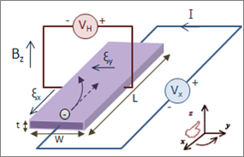
The generalized Ohm’s law – Review
The generalized Ohm’s law reads as :
$$\frac{∂\overset{⇀}{J}}{∂t}=−\frac{q_{e}}{m_{e}}⁢\overset{⇀}{∇}·{\overset{⟷}{P}}_{e}+\frac{n_{e}⁢{q_{e}}^{2}}{m_{e}}⁢\left(\overset{⇀}{E}+\overset{⇀}{v}×\overset{⇀}{B}\right)+\frac{q_{e}}{m_{e}}⁢\left(\overset{⇀}{J}×\overset{⇀}{B}\right)−\frac{n_{e}⁢{q_{e}}^{2}}{m_{e}}⁢\hat{η}·\overset{⇀}{J}$$
In simple language, it simply says:
What are the different ways we can cause the current to change? $\left(\frac{∂\overset{⇀}{J}}{∂t}\right)=…$
5. The Hall effect term $\left(\frac{q_{e}}{m_{e}}⁢\left(\overset{⇀}{J}×\overset{⇀}{B}\right)\right)$
This term is slightly more complicated, it contains $\overset{⇀}{J}$, which means that both rotation of electron velocity and ion velocity contribute. (It is that Hall effect which is commonly used to determine semiconductor type)
$$\overset{⇀}{B}$$
$\overset{⇀}{J}$(t+dt)
$\overset{⇀}{J}$(t)
$$\overset{⇀}{B}$$
$\overset{⇀}{J}$(t)
${\overset{⇀}{v}}_{e}$(t)
${\overset{⇀}{v}}_{i}$(t)
${\overset{⇀}{v}}_{e}$(t)
${\overset{⇀}{v}}_{i}$(t)
$−{\overset{⇀}{v}}_{e}$(t) $×\overset{⇀}{B}$
${\overset{⇀}{v}}_{i}$(t) $×\overset{⇀}{B}$
${\overset{⇀}{v}}_{i}$(t+dt)
${\overset{⇀}{v}}_{e}$(t+dt)

Slide 11
The generalized Ohm’s law
Slightly modified, the generalized Ohm’s law reads as :
$$\frac{∂\overset{⇀}{J}}{∂t}+\frac{q_{e}}{m_{e}}⁢\overset{⇀}{∇}·{\overset{⟷}{P}}_{e}=\frac{n_{e}⁢{q_{e}}^{2}}{m_{e}}⁢\left(\overset{⇀}{E}+\overset{⇀}{v}×\overset{⇀}{B}\right)+\frac{q_{e}}{m_{e}}⁢\left(\overset{⇀}{J}×\overset{⇀}{B}\right)−\frac{n_{e}⁢{q_{e}}^{2}}{m_{e}}⁢\hat{η}·\overset{⇀}{J}$$
Now, the fully General Relativistic version:
$$∇_{α}C^{αβ}=\frac{ω_{p}^{2}}{4⁢π}⁢\left(\frac{1}{c}⁢\left(U_{α}+h_{q}⁢𝔍_{α}\right)⁢F^{αβ}−η_{q}⁢\left(ρ_{q}⁢U^{β}+𝔍^{β}\right)\right)$$
$$C^{αβ}≡\left(ρ_{q}+\frac{ε_{q}+p_{q}}{c^{2}}\right)⁢U^{α}⁢U^{β}+U^{α}⁢{\left(𝔍′\right)}^{β}+{\left(𝔍′\right)}^{α}⁢U^{β}+p_{q}⁢g^{αβ}$$
In the rest frame of the fluid, it reads as
$$C^{αβ}=\left(\begin{matrix}ρ_{q}+\frac{ε_{q}}{c^{2}} & {\left(𝔍′\right)}^{x} & {\left(𝔍′\right)}^{y} & {\left(𝔍′\right)}^{z} \\ {\left(𝔍′\right)}^{x} & p_{q} & 0 & 0 \\ {\left(𝔍′\right)}^{y} & 0 & p_{q} & 0 \\ {\left(𝔍′\right)}^{z} & 0 & 0 & p_{q}\end{matrix}\right)$$
WTH
OK… I have to admit, my first response to this was …

Slide 12
The generalized Ohm’s law
$$∇_{α}C^{αβ}=\frac{ω_{p}^{2}}{4⁢π}⁢\left(\frac{1}{c}⁢\left(U_{α}+h_{q}⁢𝔍_{α}\right)⁢F^{αβ}−η_{q}⁢\left(ρ_{q}⁢U^{β}+𝔍^{β}\right)\right)$$
$$C^{αβ}≡\left(ρ_{q}+\frac{ε_{q}+p_{q}}{c^{2}}\right)⁢U^{α}⁢U^{β}+U^{α}⁢{\left(𝔍′\right)}^{β}+{\left(𝔍′\right)}^{α}⁢U^{β}+p_{q}⁢g^{αβ}$$
$$\frac{1}{c}⁢\left(U_{α}+h_{q}⁢𝔍_{α}\right)⁢F^{αβ}=\left(1,−h_{q}⁢\frac{𝔍_{x}}{c},−h_{q}⁢\frac{𝔍_{y}}{c},−h_{q}⁢\frac{𝔍_{z}}{c}\right)⁢\left(\begin{matrix}0 & E_{x} & E_{y} & E_{z} \\ −E_{x} & 0 & B_{z} & −B_{y} \\ −E_{y} & −B_{z} & 0 & B_{x} \\ −E_{z} & B_{y} & −B_{x} & 0\end{matrix}\right)=\left(\begin{matrix}\frac{h_{q}}{c}⁢\left(\overset{⇀}{𝔍}·\overset{⇀}{E}\right) \\ E_{x}+\frac{h_{q}}{c}⁢\left(𝔍_{y}⁢B_{z}−𝔍_{z}⁢B_{y}\right) \\ E_{y}+\frac{h_{q}}{c}⁢\left(𝔍_{z}⁢B_{x}−𝔍_{x}⁢B_{z}\right) \\ E_{z}+\frac{h_{q}}{c}⁢\left(𝔍_{x}⁢B_{y}−𝔍_{y}⁢B_{x}\right)\end{matrix}\right)$$
$$=\left(\begin{matrix}\frac{h_{q}}{c}⁢\left(\overset{⇀}{𝔍}·\overset{⇀}{E}\right) \\ {\left(\overset{⇀}{E}+\frac{h_{q}}{c}\left(\overset{⇀}{𝔍}×\overset{⇀}{B}\right)\right)}^{x} \\ {\left(\overset{⇀}{E}+\frac{h_{q}}{c}\left(\overset{⇀}{𝔍}×\overset{⇀}{B}\right)\right)}^{y} \\ {\left(\overset{⇀}{E}+\frac{h_{q}}{c}\left(\overset{⇀}{𝔍}×\overset{⇀}{B}\right)\right)}^{z}\end{matrix}\right)$$
$$η_{q}⁢\left(ρ_{q}⁢U^{β}+𝔍^{β}\right)=η_{q}⁢\left(\begin{matrix}ρ_{q}⁢c \\ 𝔍_{x} \\ 𝔍_{y} \\ 𝔍_{z}\end{matrix}\right)$$

Slide 13
The generalized Ohm’s law
$$∇_{α}C^{αβ}=\frac{ω_{p}^{2}}{4⁢π}⁢\left(\frac{1}{c}⁢\left(U_{α}+h_{q}⁢𝔍_{α}\right)⁢F^{αβ}−η_{q}⁢\left(ρ_{q}⁢U^{β}+𝔍^{β}\right)\right)$$
$$C^{αβ}≡\left(ρ_{q}+\frac{ε_{q}+p_{q}}{c^{2}}\right)⁢U^{α}⁢U^{β}+U^{α}⁢{\left(𝔍′\right)}^{β}+{\left(𝔍′\right)}^{α}⁢U^{β}+p_{q}⁢g^{αβ}$$
$$∇_{α}C^{αβ}=\left(\frac{∂}{∂t},\frac{∂}{∂x},\frac{∂}{∂y},\frac{∂}{∂z}\right)⁢\left(\begin{matrix}ρ_{q}+\frac{ε_{q}}{c^{2}} & {\left(𝔍′\right)}^{x} & {\left(𝔍′\right)}^{y} & {\left(𝔍′\right)}^{z} \\ {\left(𝔍′\right)}^{x} & p_{q} & 0 & 0 \\ {\left(𝔍′\right)}^{y} & 0 & p_{q} & 0 \\ {\left(𝔍′\right)}^{z} & 0 & 0 & p_{q}\end{matrix}\right)=\left(\begin{matrix}\frac{∂}{∂t}\left(ρ_{q}+\frac{ε_{q}}{c^{2}}\right)+\overset{⇀}{∇}·\overset{⇀}{𝔍}′ \\ \frac{∂{\left(𝔍′\right)}^{x}}{∂t}+\frac{∂p_{q}}{∂x} \\ \frac{∂{\left(𝔍′\right)}^{y}}{∂t}+\frac{∂p_{q}}{∂y} \\ \frac{∂{\left(𝔍′\right)}^{z}}{∂t}+\frac{∂p_{q}}{∂z}\end{matrix}\right)=\left(\begin{matrix}\frac{∂}{∂t}\left(ρ_{q}+\frac{ε_{q}}{c^{2}}\right)+\overset{⇀}{∇}·\overset{⇀}{𝔍}′ \\ {\left(\frac{∂𝔍′}{∂t}+∇p_{g}\right)}^{x} \\ {\left(\frac{∂𝔍′}{∂t}+∇p_{g}\right)}^{y} \\ {\left(\frac{∂𝔍′}{∂t}+∇p_{g}\right)}^{z}\end{matrix}\right)$$

Slide 14
The generalized Ohm’s law— putting it together
$$∇_{α}C^{αβ}=\frac{ω_{p}^{2}}{4⁢π}⁢\left(\frac{1}{c}⁢\left(U_{α}+h_{q}⁢𝔍_{α}\right)⁢F^{αβ}−η_{q}⁢\left(ρ_{q}⁢U^{β}+𝔍^{β}\right)\right)$$
$$C^{αβ}≡\left(ρ_{q}+\frac{ε_{q}+p_{q}}{c^{2}}\right)⁢U^{α}⁢U^{β}+U^{α}⁢{\left(𝔍′\right)}^{β}+{\left(𝔍′\right)}^{α}⁢U^{β}+p_{q}⁢g^{αβ}$$
I have no idea what these two terms mean…
$$\left(\begin{matrix}\frac{∂}{∂t}\left(ρ_{q}+\frac{ε_{q}}{c^{2}}\right)+\overset{⇀}{∇}·\overset{⇀}{𝔍}′ \\ {\left(\frac{∂𝔍′}{∂t}+∇p_{g}\right)}^{x} \\ {\left(\frac{∂𝔍′}{∂t}+∇p_{g}\right)}^{y} \\ {\left(\frac{∂𝔍′}{∂t}+∇p_{g}\right)}^{z}\end{matrix}\right)=\frac{ω_{p}^{2}}{4⁢π}⁢\left(\begin{matrix}\frac{h_{q}}{c}⁢\left(\overset{⇀}{𝔍}·\overset{⇀}{E}\right)−η_{q}⁢ρ_{q}⁢c \\ {\left(\overset{⇀}{E}+\frac{h_{q}}{c}\left(\overset{⇀}{𝔍}×\overset{⇀}{B}\right)\right)}^{x}−η_{q}⁢𝔍^{x} \\ {\left(\overset{⇀}{E}+\frac{h_{q}}{c}\left(\overset{⇀}{𝔍}×\overset{⇀}{B}\right)\right)}^{y}−η_{q}⁢𝔍^{y} \\ {\left(\overset{⇀}{E}+\overset{⇀}{\frac{h_{q}}{c}\left(\overset{⇀}{𝔍}×\overset{⇀}{B}\right)}\right)}^{z}−η_{q}⁢𝔍^{z}\end{matrix}\right)$$
The GR version of the generalized Ohm’s law in the “Local frame of the fluid”
In the local frame, $\overset{⇀}{v}=0$
The generalized Ohm’s law in classical theory.
$$\frac{∂\overset{⇀}{J}}{∂t}+\frac{q_{e}}{m_{e}}⁢\overset{⇀}{∇}·{\overset{⟷}{P}}_{e}=\frac{n_{e}⁢{q_{e}}^{2}}{m_{e}}⁢\left(\overset{⇀}{E}+\overset{⇀}{v}×\overset{⇀}{B}\right)+\frac{q_{e}}{m_{e}}⁢\left(\overset{⇀}{J}×\overset{⇀}{B}\right)−\frac{n_{e}⁢{q_{e}}^{2}}{m_{e}}⁢\hat{η}·\overset{⇀}{J}$$
Pressure
Gradient
Plasma motion
Hall
Resistive

Slide 15
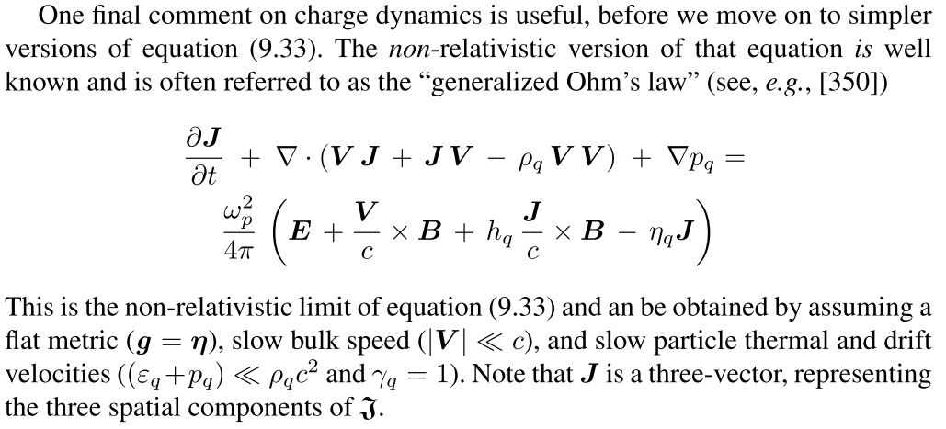
Comparison with the 3D version
$$\frac{∂\overset{⇀}{J}}{∂t}+\frac{q_{e}}{m_{e}}⁢\overset{⇀}{∇}·{\overset{⟷}{P}}_{e}=\frac{n_{e}⁢{q_{e}}^{2}}{m_{e}}⁢\left(\overset{⇀}{E}+\overset{⇀}{v}×\overset{⇀}{B}\right)+\frac{q_{e}}{m_{e}}⁢\left(\overset{⇀}{J}×\overset{⇀}{B}\right)−\frac{n_{e}⁢{q_{e}}^{2}}{m_{e}}⁢\hat{η}·\overset{⇀}{J}$$
Convective terms that were ignored in Plasma class.
In a general frame, the $\overset{⇀}{v}×\overset{⇀}{B}$ term comes back.

Slide 16
The terms in the Generalized Ohm’s Law
$$\left(\begin{matrix}\frac{∂}{∂t}\left(ρ_{q}+\frac{ε_{q}}{c^{2}}\right)+\overset{⇀}{∇}·\overset{⇀}{𝔍}′ \\ {\left(\frac{∂𝔍′}{∂t}+∇p_{g}\right)}^{x} \\ {\left(\frac{∂𝔍′}{∂t}+∇p_{g}\right)}^{y} \\ {\left(\frac{∂𝔍′}{∂t}+∇p_{g}\right)}^{z}\end{matrix}\right)=\frac{ω_{p}^{2}}{4⁢π}⁢\left(\begin{matrix}\frac{h_{q}}{c}⁢\left(\overset{⇀}{𝔍}·\overset{⇀}{E}\right)−η_{q}⁢ρ_{q}⁢c \\ {\left(\overset{⇀}{E}+\frac{h_{q}}{c}\left(\overset{⇀}{𝔍}×\overset{⇀}{B}\right)\right)}^{x}−η_{q}⁢𝔍^{x} \\ {\left(\overset{⇀}{E}+\frac{h_{q}}{c}\left(\overset{⇀}{𝔍}×\overset{⇀}{B}\right)\right)}^{y}−η_{q}⁢𝔍^{y} \\ {\left(\overset{⇀}{E}+\overset{⇀}{\frac{h_{q}}{c}\left(\overset{⇀}{𝔍}×\overset{⇀}{B}\right)}\right)}^{z}−η_{q}⁢𝔍^{z}\end{matrix}\right)$$
The GR version of the generalized Ohm’s law in the “Local frame of the fluid”
Spatial current $\overset{⇀}{𝔍}≡\underset{i}{Σ}⁢q_{i}⁢\int{\overset{⇀}{v}⁢f⁢\left(\overset{⇀}{v}\right)⁢d^{3}⁢\overset{⇀}{v}}$
Lorentz enhanced version of the spatial current ${\overset{⇀}{𝔍}}^{′}≡\underset{i}{Σ}⁢q_{i}⁢\int{γ⁢\overset{⇀}{v}⁢f⁢\left(\overset{⇀}{v}\right)⁢d^{3}⁢\overset{⇀}{v}}$

Slide 17
The terms in the Generalized Ohm’s Law
$$\left(\begin{matrix}\frac{∂}{∂t}\left(ρ_{q}+\frac{ε_{q}}{c^{2}}\right)+\overset{⇀}{∇}·\overset{⇀}{𝔍}′ \\ {\left(\frac{∂𝔍′}{∂t}+∇p_{g}\right)}^{x} \\ {\left(\frac{∂𝔍′}{∂t}+∇p_{g}\right)}^{y} \\ {\left(\frac{∂𝔍′}{∂t}+∇p_{g}\right)}^{z}\end{matrix}\right)=\frac{ω_{p}^{2}}{4⁢π}⁢\left(\begin{matrix}\frac{h_{q}}{c}⁢\left(\overset{⇀}{𝔍}·\overset{⇀}{E}\right)−η_{q}⁢ρ_{q}⁢c \\ {\left(\overset{⇀}{E}+\frac{h_{q}}{c}\left(\overset{⇀}{𝔍}×\overset{⇀}{B}\right)\right)}^{x}−η_{q}⁢𝔍^{x} \\ {\left(\overset{⇀}{E}+\frac{h_{q}}{c}\left(\overset{⇀}{𝔍}×\overset{⇀}{B}\right)\right)}^{y}−η_{q}⁢𝔍^{y} \\ {\left(\overset{⇀}{E}+\overset{⇀}{\frac{h_{q}}{c}\left(\overset{⇀}{𝔍}×\overset{⇀}{B}\right)}\right)}^{z}−η_{q}⁢𝔍^{z}\end{matrix}\right)$$
The GR version of the generalized Ohm’s law in the “Local frame of the fluid”
Plasma frequency $ω_{p}^{2}≡4⁢π⁢\underset{i}{Σ}⁢\frac{{q_{i}}^{2}⁢n_{i}}{m_{i}}≈4⁢π⁢\frac{n_{e}⁢e^{2}}{m_{e}}$
Hall coefficient $h_{q}≡\frac{4⁢π}{ω_{p}^{2}|\overset{⇀}{𝔍}|}⁢\underset{i}{Σ}⁢\frac{q_{i}}{m_{i}}|{\overset{⇀}{𝔍}}_{i}|≈\frac{1}{n_{e}⁢e}$
Resistivity $η_{q}≡4⁢π⁢\frac{ν_{coll}}{ω_{p}^{2}}$
These terms can be determined through the equation of states:
$ε_{q}⁢=ε_{q}⁢\left(ρ,T\right)$ $p_{q}⁢=p_{q}⁢\left(ρ,T\right)$
$⁢ω_{p}⁢=ω_{p}⁢\left(ρ,T\right)$ $⁢h_{q}⁢=h_{q}⁢\left(ρ,T\right)$
$⁢η_{q}=η_{q}\left(ρ,T\right)$

Slide 18
Full stress-energy tensor for gas
$${T^{αβ}}_{gas}={T^{αβ}}_{fluid}+{T^{αβ}}_{Conduction}+{T^{αβ}}_{Viscosity}=\left(\left(ρ+p+\frac{ε}{c^{2}}\right)⁢U^{α}⁢U^{β}+g^{αβ}⁢p \right)+\left(\frac{1}{c^{2}}⁢\left(Q_{g}^{α}⁢U^{β}+U^{α}⁢Q_{g}^{β}\right)\right)+\left(−2⁢η_{v,g}⁢Σ^{αβ}−ζ_{v,g}⁢Θ⁢P^{αβ}\right)$$
$${\left(T^{αβ}\right)}_{fluid}=\left(\begin{matrix}ρ+ε & 0 & 0 & 0 \\ 0 & p & 0 & 0 \\ 0 & 0 & p & 0 \\ 0 & 0 & 0 & p\end{matrix}\right)$$
$${\left(T^{αβ}\right)}_{Conduction}=\left(\begin{matrix}0 & Q_{g}^{x} & Q_{g}^{y} & Q_{g}^{z} \\ Q_{g}^{x} & 0 & 0 & 0 \\ Q_{g}^{y} & 0 & 0 & 0 \\ Q_{g}^{z} & 0 & 0 & 0\end{matrix}\right)$$
$${\left(T^{αβ}\right)}_{Viscosity}=\left(\begin{matrix}0 & 0 & 0 & 0 \\ 0 & −2⁢η_{v,g}⁢Σ^{xx}−ζ_{v,g}⁢Θ & −2⁢η_{v,g}⁢Σ^{xy} & −2⁢η_{v,g}⁢Σ^{xz} \\ 0 & −2⁢η_{v,g}⁢Σ^{yx} & −2⁢η_{v,g}⁢Σ^{yy}−ζ_{v,g}⁢Θ & −2⁢η_{v,g}⁢Σ^{yz} \\ 0 & −2⁢η_{v,g}⁢Σ^{zx} & −2⁢η_{v,g}⁢Σ^{zy} & −2⁢η_{v,g}⁢Σ^{zz}−ζ_{v,g}⁢Θ\end{matrix}\right)$$
$${\left(T^{αβ}\right)}_{gas}=\left(\begin{matrix}{ρc}^{2}+ε_{g} & Q_{g}^{x} & Q_{g}^{y} & Q_{g}^{z} \\ Q_{g}^{x} & −2⁢η_{v,g}⁢Σ^{xx}−ζ_{v,g}⁢Θ+p_{g} & −2⁢η_{v,g}⁢Σ^{xy} & −2⁢η_{v,g}⁢Σ^{xz} \\ Q_{g}^{y} & −2⁢η_{v,g}⁢Σ^{yx} & −2⁢η_{v,g}⁢Σ^{yy}−ζ_{v,g}⁢Θ+p_{g} & −2⁢η_{v,g}⁢Σ^{yz} \\ Q_{g}^{z} & −2⁢η_{v,g}⁢Σ^{zx} & −2⁢η_{v,g}⁢Σ^{zy} & −2⁢η_{v,g}⁢Σ^{zz}−ζ_{v,g}⁢Θ+p_{g}\end{matrix}\right)$$

Slide 19
Structure similarity with the energy-momentum tensor
$$∇_{α}C^{αβ}=\frac{ω_{p}^{2}}{4⁢π}⁢\left(\frac{1}{c}⁢\left(U_{α}+h_{q}⁢𝔍_{α}\right)⁢F^{αβ}−η_{q}⁢\left(ρ_{q}⁢U^{β}+𝔍^{β}\right)\right)$$
$$C^{αβ}≡\left(ρ_{q}+\frac{ε_{q}+p_{q}}{c^{2}}\right)⁢U^{α}⁢U^{β}+U^{α}⁢{\left(𝔍′\right)}^{β}+{\left(𝔍′\right)}^{α}⁢U^{β}+p_{q}⁢g^{αβ}$$
In the rest frame of the fluid, $C^{αβ}=\left(\begin{matrix}ρ_{q}+\frac{ε_{q}}{c^{2}} & {\left(𝔍′\right)}^{x} & {\left(𝔍′\right)}^{y} & {\left(𝔍′\right)}^{z} \\ {\left(𝔍′\right)}^{x} & p_{q} & 0 & 0 \\ {\left(𝔍′\right)}^{y} & 0 & p_{q} & 0 \\ {\left(𝔍′\right)}^{z} & 0 & 0 & p_{q}\end{matrix}\right)$
$${\left(T^{αβ}\right)}_{gas}=\left(\begin{matrix}{ρc}^{2}+ε_{g} & Q_{g}^{x} & Q_{g}^{y} & Q_{g}^{z} \\ Q_{g}^{x} & −2⁢η_{v,g}⁢Σ^{xx}−ζ_{v,g}⁢Θ+p_{g} & −2⁢η_{v,g}⁢Σ^{xy} & −2⁢η_{v,g}⁢Σ^{xz} \\ Q_{g}^{y} & −2⁢η_{v,g}⁢Σ^{yx} & −2⁢η_{v,g}⁢Σ^{yy}−ζ_{v,g}⁢Θ+p_{g} & −2⁢η_{v,g}⁢Σ^{yz} \\ Q_{g}^{z} & −2⁢η_{v,g}⁢Σ^{zx} & −2⁢η_{v,g}⁢Σ^{zy} & −2⁢η_{v,g}⁢Σ^{zz}−ζ_{v,g}⁢Θ+p_{g}\end{matrix}\right)$$

Slide 20
How do we solve them?
For simplicity, let’s look at the local frame of the fluid. The generalized Ohm’s law then looks like:
$$\left(\begin{matrix}\frac{∂}{∂t}\left(ρ_{q}+\frac{ε_{q}}{c^{2}}\right)+\overset{⇀}{∇}·\overset{⇀}{𝔍}′ \\ {\left(\frac{∂𝔍′}{∂t}+∇p_{g}\right)}^{x} \\ {\left(\frac{∂𝔍′}{∂t}+∇p_{g}\right)}^{y} \\ {\left(\frac{∂𝔍′}{∂t}+∇p_{g}\right)}^{z}\end{matrix}\right)=\frac{ω_{p}^{2}}{4⁢π}⁢\left(\begin{matrix}\frac{h_{q}}{c}⁢\left(\overset{⇀}{𝔍}·\overset{⇀}{E}\right)−η_{q}⁢ρ_{q}⁢c \\ {\left(\overset{⇀}{E}+\frac{h_{q}}{c}\left(\overset{⇀}{𝔍}×\overset{⇀}{B}\right)\right)}^{x}−η_{q}⁢𝔍^{x} \\ {\left(\overset{⇀}{E}+\frac{h_{q}}{c}\left(\overset{⇀}{𝔍}×\overset{⇀}{B}\right)\right)}^{y}−η_{q}⁢𝔍^{y} \\ {\left(\overset{⇀}{E}+\overset{⇀}{\frac{h_{q}}{c}\left(\overset{⇀}{𝔍}×\overset{⇀}{B}\right)}\right)}^{z}−η_{q}⁢𝔍^{z}\end{matrix}\right)$$
These three equations allow us to take a time step for $𝔍′$.
This equation allows us to determine $γ_{q}$. (How?)
$\overset{⇀}{𝔍}′=γ_{q}⁢\overset{⇀}{𝔍}$ helps us to find $\overset{⇀}{𝔍}$ and $U^{α}⁢𝔍_{α}=0$ helps to find $𝔍^{α}⁢$
Then from charge continuity, $∇_{α}J^{α}=0$ and $J^{α}=ρ_{q}⁢U^{α}+𝔍^{α}$ we can update $ρ_{q}$.
With the new 4-current, we can update the fields using Maxwell’s equations.

Slide 21
Relativistic Hall MHD
The generalized Ohm’s law reads as:
$$∇_{α}C^{αβ}=\frac{ω_{p}^{2}}{4⁢π}⁢\left(\frac{1}{c}⁢\left(U_{α}+h_{q}⁢𝔍_{α}\right)⁢F^{αβ}−η_{q}⁢\left(ρ_{q}⁢U^{β}+𝔍^{β}\right)\right)$$
However, in most cases, $\frac{ω_{p}^{2}}{4⁢π}$ is very large that we can forget about the $∇_{α}C^{αβ}$ term.
This reduces the equation to
$$\frac{1}{c}⁢\left(U_{α}+h_{q}⁢𝔍_{α}\right)⁢F^{αβ}=η_{q}⁢\left(ρ_{q}⁢U^{β}+𝔍^{β}\right)$$
In which we find that the beamed current $({𝔍′)}^{β}$ is gone (it is in the $C^{αβ}$ term)
Therefore, we no longer need $γ_{q}$. This in turn means that the ‘t’ component of the Ohm’s law which was used to determine $γ_{q}$ now is useless.
To simplify, we can project out the spatial current $𝔍^{β}$:
$$\frac{U_{α}}{c}⁢F^{αβ}+h_{q}⁢\frac{𝔍^{γ}}{c}⁢F^{αβ}⁢P_{γα}=η_{q}⁢𝔍^{β}$$
In non-relativistic case, it’s simply $\overset{⇀}{E}+h_{q}⁢\frac{\overset{⇀}{J}}{c}×\overset{⇀}{B}=η_{q}⁢\overset{⇀}{J}$

Slide 22
Relativistic Resistive MHD
Another simplification that is often used it to drop the Hall term in the following equation we got just now:
$$\frac{U_{α}}{c}⁢F^{αβ}+h_{q}⁢\frac{𝔍^{γ}}{c}⁢F^{αβ}⁢P_{γα}=η_{q}⁢𝔍^{β}$$
Hall term
By comparing the Hall and resistive(collision) terms,
$$\frac{h_{q}|𝔍^{α}||\overset{⇀}{B}|/c}{η_{q}|𝔍^{α}|}≈\frac{eB}{m_{e}⁢c}⁢\frac{1}{ν_{coll}}=\frac{ν_{L}}{ν_{coll}}⁢<<1$$
we can argue that since many collisions can occur within a Larmor orbit, the $\frac{\overset{⇀}{J}}{c}×\overset{⇀}{B}$ term will not contribute much…????????
Plugging in the numbers gives…
$ν_{L}=1.76×{10}^{7}B$ for B~1mG, this is of order 10000….
$ν_{coll}=\frac{3.41}{T^{3/2}}n$ for T~${10}^{8}$, n~${10}^{15}$ this is of order 1000…
What the hell happened with the ratio!?

Slide 23
Relativistic Ideal MHD
The last simplification to make is to consider dropping off the resistive term.
$$\frac{U_{α}}{c}⁢F^{αβ}=η_{q}⁢𝔍^{β}$$
We estimate the conductivity as follows $\left(V_{th}≈\sqrt{\frac{kT}{m_{e}}};r_{e}=\frac{e^{2}}{kT}\right)$:
$$σ_{q}≡\frac{1}{η_{q}}=\frac{ω_{p}^{2}}{4⁢{πν}_{coll}}≈\left(\frac{n_{e}⁢e^{2}}{m_{e}}\right)⁢\frac{1}{n_{e}⁢\left({{πr}_{e}}^{2}\right)⁢V_{th}}≈\frac{{\left(2⁢kT\right)}^{\frac{3}{2}}}{{πe}^{2}⁢\sqrt{m_{e}}}\sim 2.1×{10}^{8}⁢s^{−1}⁢T^{1.5}$$
For $T={10}^{6}\sim {10}^{10}K$, this gives $σ_{q}={10}^{17}\sim {10}^{23}$ $s^{−1}$ >>$5×{10}^{16}$ for copper!
Given the extreme lack of electrical resistance in astrophysical plasmas, one can safely ignore the resistivity term, leading to the simple “ideal” Ohm’s law expression
$$\frac{U_{α}}{c}⁢F^{αβ}=0$$

Slide 24
Relativistic Ideal MHD
In the non-relativistic limit and evaluating in the lab frame, $\frac{U_{α}}{c}⁢F^{αβ}=0$ becomes $\overset{⇀}{E}=−\frac{\overset{⇀}{v}}{c}×\overset{⇀}{B}$ which is the familiar ideal Ohm’s law expression.
I personally think that it should not only be Ideal MHD that deserves this comment, starting from the step when we dropped off the $\frac{∂\overset{⇀}{J}}{∂t}$ term to get the Hall-MHD, it becomes basically impossible to directly update the current…

Slide 25
Flux freezing in actual simulations

Slide 26
Optically thin Radiative Emission (Ch9.4)

Slide 27
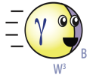
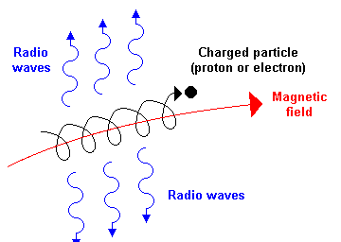
Optically thin radiation heat transfer –an Introduction
Scattering
matter
matter
Previously, we discuss the heat transfer by radiation by considering the opacity, which means that we’re considering radiation transferring heat within the system – being eaten or scattered within the system.
嗝
Ahhhh…
Absroption
Ow!
Now we consider photons that are allowed to escape the system and thereby carrying energy with them. And the spectrum remains approximately that of the emission process.
matter
Whee~
$${\overset{.}{q}}_{r}=\frac{1}{ρ}⁢\overset{⇀}{∇}·{\overset{⇀}{Q}}_{r}=−\frac{c}{3⁢ρ}⁢\overset{⇀}{∇}·\left[\frac{∇ε_{r}}{{\overset{−}{κ}}_{R,bf}}\right]$$
Synchrotron Emission
We discuss the following processes:
Inverse Compton
Bremsstrahlung

Slide 28
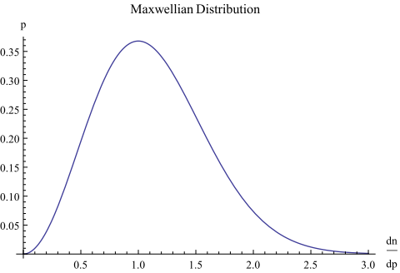
The BIG assumption
We consider the different types of emission radiated from a thermal distribution of particles! (For example, Maxwellian for a classical gas)
$$p^{2}⁢ⅇ^{−\frac{p^{2}}{2⁢m_{0}⁢kT}}$$

Slide 29
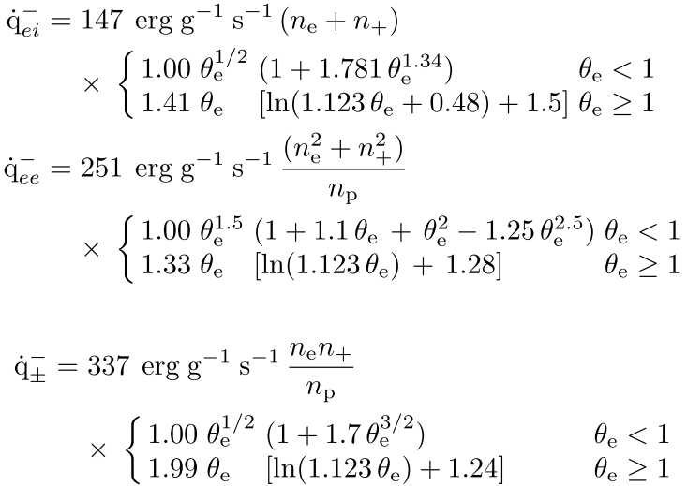
Bremsstrahlung (Free-Free Emission)
$$e^{−}⁢−ion;e^{+}−ion$$
$$e^{−}⁢e^{−};e^{+}⁢e^{+}$$
$$e^{−}⁢e^{+}$$
How do we understand these trends in a simpler manner?

Slide 30
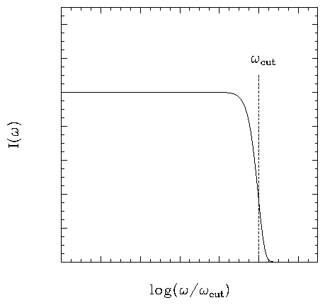
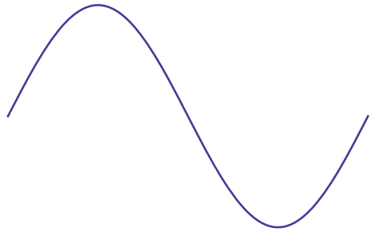
Bremsstrahlung (Free-Free Emission)
$$v_{i}$$
Assuming that the v magnitude doesn’t change much, then the time that the charge takes to fly past is $τ\sim \frac{b}{v}$.
The emitted frequency (being the Fourier transform of time) therefore would have a cut off at $ω_{cut}\sim \frac{v}{b}$.
$$τ\sim \frac{b}{v}$$
b
+
$$v_{i}$$
$$v_{f}$$
$$Δv$$
$$ω_{cut}\sim \frac{v}{b}$$
Constructive!
+
For the low frequency waves, the interaction time is much shorter than the inverse of its frequency. Thus, these waves will be coherent with those emitted a small time ago of the same frequency.
This leads to $\frac{dE}{dω}∝{Δv}^{2}$

Slide 31
Bremsstrahlung (Free-Free Emission)
$$v_{i}$$
$$\frac{dE}{dω}∝{Δv}^{2}$$
Now, we can estimate the change in velocity $Δv$ by integrating over the acceleration history of the particle
$Δv=\frac{{Ze}^{2}}{m}⁢\int_{−∞}^{∞}{\frac{b⁢dt}{{\left(\sqrt{b^{2}+{\left(vt\right)}^{2}}\right)}^{3}}}=\frac{2⁢Z⁢e^{2}}{m⁢b⁢v}∝\frac{1}{m⁢b⁢v}$
This gives $\frac{dE}{dω}∝\frac{1}{m^{2}⁢b^{2}⁢v^{2}}$
b
+
$$v_{i}$$
$$v_{f}$$
$$Δv$$
Since in astrophysics, there are usually a large number of particles, we now consider a flux of particles shooting at stationary targets.
$$n_{i}$$
$$n_{t}$$
The emitted power per unit volume per unit frequency is then
$$\frac{dE}{dωdVdt}∝\int_{b_{min}}^{b_{max}}{\frac{1}{m^{2}⁢b^{2}⁢v^{2}}n_{t}⁢\left(n_{i}⁢v\right)⁢\left(2⁢π⁢b⁢db\right)}$$
Number of incident particles per unit time at a particular impact parameter

Slide 32
Thermal Bremsstrahlung
$$\frac{dE}{dωdVdt}∝\int_{b_{min}}^{b_{max}}{\left.\frac{1}{m^{2}⁢b^{2}⁢v^{2}}[n_{t}⁢\left(n_{i}⁢v\right)⁢\left(2⁢π⁢b⁢db\right)\right]}∝\frac{n_{t}⁢n_{i}}{m^{2}⁢v}⁢ℓn⁢\left(\frac{b_{max}}{b_{min}}\right)$$
Gaunt factor ($\overset{−}{g}$), in general some complicated function of order unity.
For a thermal population of particles, for a quick estimate, we can characterized the velocity by the thermal velocity
$$v_{th}∝\sqrt{\frac{T}{m}}$$
which gives
$$\frac{dE}{dωdVdt}∝\frac{n_{t}⁢n_{i}}{m^{1.5}⁢\sqrt{T}}⁢\overset{−}{g}$$
$$p^{2}⁢ⅇ^{−\frac{p^{2}}{2⁢m_{0}⁢kT}}$$

Slide 33
Thermal Bremsstrahlung—total power
$$\frac{dE}{dVdt}=\int{\frac{dE}{dωdVdt}⁢dω}∝\int{\frac{n_{t}⁢n_{i}}{m^{1.5}⁢\sqrt{T}}⁢\overset{−}{g}⁢dω}$$
Using the fact that the spectra can be approximated by a box function,
$$≈\frac{n_{t}⁢n_{i}}{m^{1.5}⁢\sqrt{T}}⁢\overset{−}{g}⁢ω_{cut}$$
$$ω_{cut}\sim \frac{v}{b}$$
For $ω_{cut}$, the ‘b’ that gives the highest frequency is obviously the smallest b, i.e. $b_{min}^{}$.
Here, we can have two cases:
1. The emitting particles have less energy and a large portion is radiated.
$$b_{min}^{\left(1\right)}=\frac{h}{mv}→\frac{v}{b_{min}^{\left(1\right)}}∝\frac{{mv}^{2}}{h}∝\frac{T}{h}$$
2. The emitting particles are very energetic and only give away a small portion of their kinetic energy to radiation.
This idea works but seems slightly incompatible to the picture given in Rybicki & Lightman p158…
$$b_{min}^{\left(2\right)}∝\frac{1}{{mv}^{2}}→\frac{v}{b_{min}^{\left(2\right)}}∝{mv}^{3}∝\frac{T^{1.5}}{\sqrt{m}}$$

Slide 34
Thermal Bremsstrahlung—total power
Power per unit volume $\frac{dE}{dVdt}≈\frac{n_{t}⁢n_{i}}{m^{1.5}⁢\sqrt{T}}⁢\overset{−}{g}⁢ω_{cut}$
1. The emitting particles have less energy and a large portion is radiated.
$$b_{min}^{\left(1\right)}=\frac{h}{mv}→\frac{v}{b_{min}^{\left(1\right)}}∝\frac{{mv}^{2}}{h}∝\frac{T}{h}$$
Power per unit volume:
$$\frac{dE}{dVdt}∝\frac{n_{t}⁢n_{i}}{h⁢m^{1.5}}⁢\sqrt{T}⁢\overset{−}{g}$$
Power per unit mass:
$$\frac{dE}{{dt dm}_{tot}}∝\frac{1}{m_{p}⁢n_{p}}⁢\frac{n_{t}⁢n_{i}}{h⁢m^{1.5}}⁢\sqrt{T}⁢\overset{−}{g}$$
2. The emitting particles are very energetic and only give away a small portion of their kinetic energy to radiation.
$$b_{min}^{\left(2\right)}∝\frac{1}{{mv}^{2}}→\frac{v}{b_{min}^{\left(2\right)}}∝{mv}^{3}∝\frac{T^{1.5}}{\sqrt{m}}$$
Power per unit volume:
$$\frac{dE}{dVdt}∝\frac{n_{t}⁢n_{i}}{m^{2}}⁢T⁢\overset{−}{g}$$
Power per unit mass:
$$\frac{dE}{{dt dm}_{tot}}∝\frac{1}{m_{p}⁢n_{p}}⁢\frac{n_{t}⁢n_{i}}{⁢m^{2}}⁢T ⁢\overset{−}{g}$$

Slide 35
Thermal Bremsstrahlung
Case1: Low energy
$$\frac{dE}{{dt dm}_{tot}}∝\frac{1}{m_{p}⁢n_{p}}⁢\frac{n_{t}⁢n_{i}}{h⁢m^{1.5}} ⁢\sqrt{T}⁢ \overset{−}{g}$$
Case2: High energy
$$\frac{dE}{{dt dm}_{tot}}∝\frac{1}{m_{p}⁢n_{p}}⁢\frac{n_{t}⁢n_{i}}{⁢m^{2}}⁢ T ⁢\overset{−}{g}$$
$$e^{−}⁢−ion;e^{+}−ion$$
$$e^{−}⁢e^{−};e^{+}⁢e^{+}$$
What’s caused the difference in this case?
$$e^{−}⁢e^{+}$$
I’m not quite sure whether the $m^{1.5}$ causes the difference between 147 and 337 for the $e^{−}⁢−ion;e^{+}−ion$ v.s. $e^{−}⁢e^{+}$ case. Using the reduced mass gives an overestimate of 20%...

Slide 36
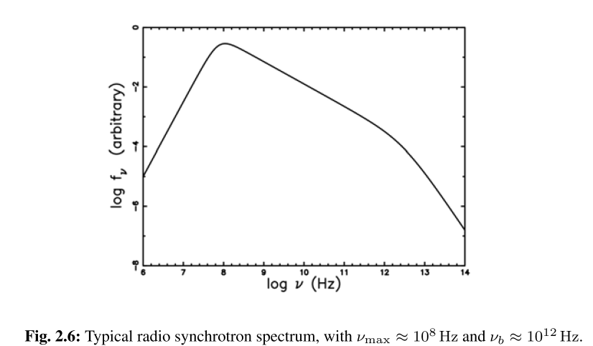
Thermal Synchrotron
The local synchrotron cooling rate is approximated as a sum of optically thick and thin emission:
$${\overset{.}{q}}_{s}^{−}=\frac{2⁢{πkT}_{e}}{3⁢{Hc}^{2}}⁢{ν_{c}}^{3}+\int_{ν_{c}}^{∞}{ε_{s}⁢\left(ν\right)⁢dν}$$
Turnover
frequency
Break
frequency
*Note that there is some confusion in the units here, ${\overset{.}{q}}_{s}^{−}$ should be erg/g/s but for the synchrotron part, all units are erg/s/${cm}^{3}$
I think just dividing by the mean density of the plasma should fix the small bug:
$${\overset{.}{q}}_{s}^{−}=\frac{1}{ρ}⁢\left(\frac{2⁢π⁢{kT}_{e}}{3⁢H⁢c^{2}}⁢ν_{c}^{3}+\int_{ν_{c}}^{∞}{ε_{s}⁢\left(ν\right)⁢dν}\right)$$
Optically
thick
emission
Optically thin power law
Synchrotron emission
Therefore, for the Synchrotron section, we will follow the book but keep in mind the small difference.

Slide 37
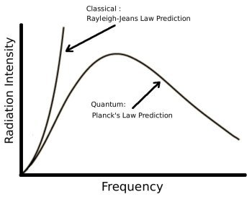
Thermal Synchrotron –Optically thick part
Since we are considering a Thermal distribution of emitting particles, the optically thick emission can be approximated by Rayleigh-Jeans Law
Then, calculating the power per unit volume gives:
$$\frac{dE}{dVdt}≈\frac{π}{H}⁢\int{B_{ν}⁢\left(T\right)⁢dν}=\frac{2⁢π⁢{kT}_{e}}{3⁢{Hc}^{2}}⁢{ν_{c}}^{3}$$
As given in the textbook.
$$B_{ν}⁢\left(T\right)=\frac{2⁢kT}{c^{2}}⁢ν^{2}$$
$${\overset{.}{q}}_{s}^{−}=\frac{2⁢{πkT}_{e}}{3⁢{Hc}^{2}}⁢{ν_{c}}^{3}+\int_{ν_{c}}^{∞}{ε_{s}⁢\left(ν\right)⁢dν}$$
*Note that in most texts, one will see that the intensity of optically thick synchrotron is $I_{ν,thick}⁢\left(ν\right)∝ν^{2.5}$. That is derived using a Power Law population of emitters, not thermal (as is assumed here)!

Slide 38
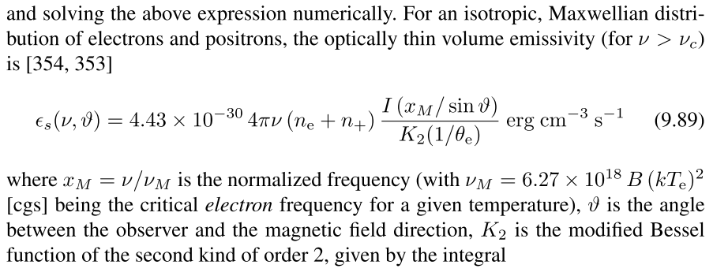
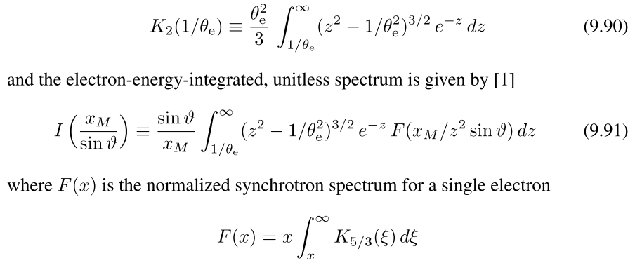
Thermal Synchrotron –Optically thin part
Normalizing the integration
Radio astrophysics. Nonthermal processes in galactic and extragalactic sources by Pacholczyk, A. G
Integrate over relativistic Maxwellian???
1996ApJ...465..327M
1996ApJ...465..312E

Slide 39
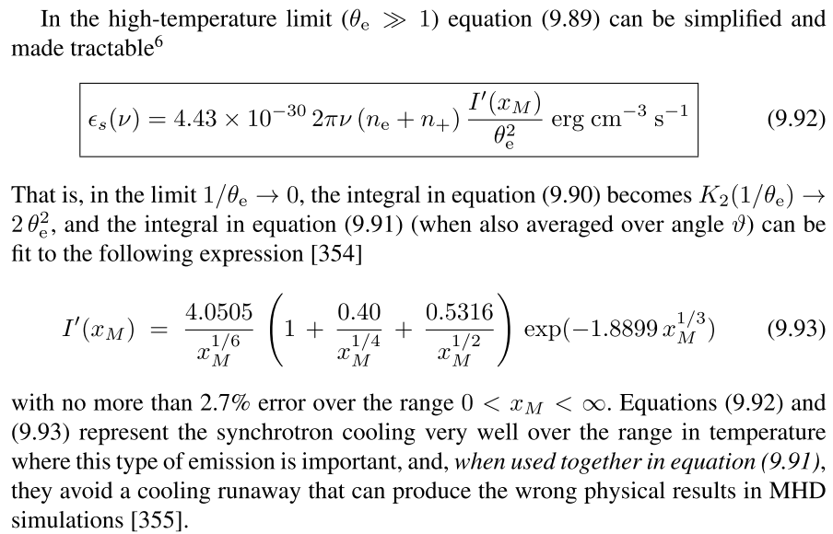
Thermal Synchrotron –Optically thin part

Slide 40
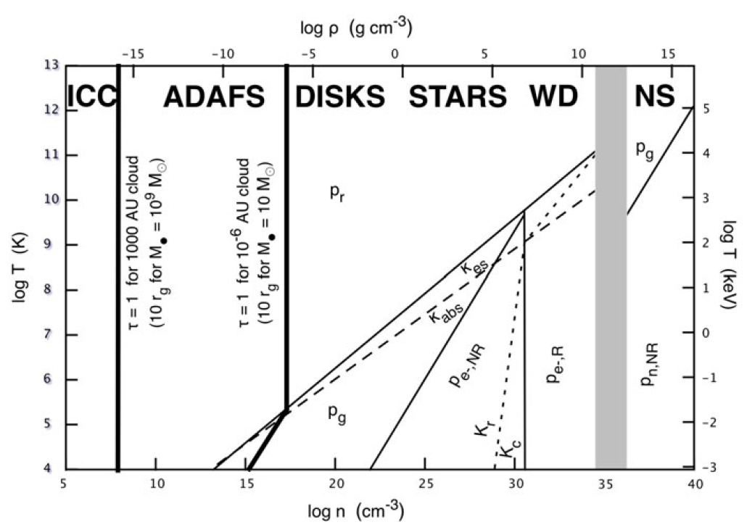
Comptonization – Why we are interested
From what we introduced last week about the opacities of electron scattering and absorption, we find from the figure below that electron scattering is more important.
Electron Scattering Dominates

Slide 41
Comptonization – Inverse Compton
In each of these photon scatterings, if the electron and photon energies are very different, an inelastic scattering (the Compton process) will occur, either raising or lowering the photon energy in the process. In most cases we will encounter, the photons will be cooler than the electrons, resulting in raising the energy of the photons and, therefore, cooling the hot, electron-scattering plasma in the process.

Slide 42
Comptonization
Since Compton scattering itself doesn’t create new photons, what is does is to use the photons emitted by synchrotron and Bremstrahlung to steal more energy from the system.
Therefore, one way to write the cooling rate is to multiply some Compton-enhancement factor $η_{C}⁢\left(ν\right)$
$$\overset{.}{q}=η_{br,C}⁢{\overset{.}{q}}_{br}^{−}+η_{s,C}⁢{\overset{.}{q}}_{s}^{−}$$

Slide 43
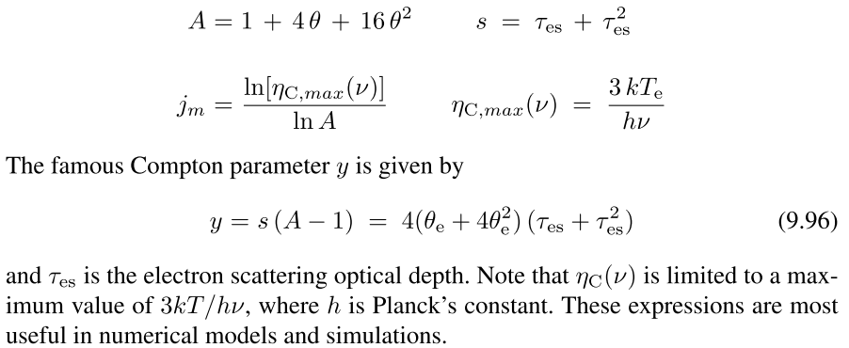
Comptonization

Slide 44
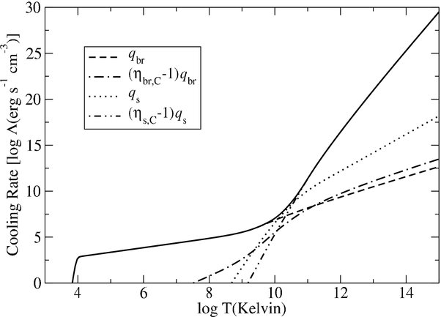
$ρ={10}^{−10}⁢g·{cm}^{−3}$ ; $B=8380⁢G$ ; $H=2.7×{10}^{7}⁢cm$
$${10}^{9}⁢K≲T_{e}$$
Compton Enhanced Synchrotron dominated
$${10}^{9}⁢K≲T_{e}$$
Synchrotron dominated
$${10}^{4}⁢K≲T_{e}≲{10}^{9}⁢K$$
Bremsstrahlung dominated
Bremsstrahlung quenched due to recombination of free electrons with ions.
2009ApJ...693..771F

Slide 45
Repeated Scattering
After the initial emission of Bremsstrahlung or synchrotron photons, if the optical depth $τ_{es}$ is high, these photons do not immediately leave the plasma.
They remain within the hot medium, gaining energy from most of the inelastic scatterings they encounter. Depending on how large the Compton y parameter is, this can drastically affect the ﬁnal spectrum that emerges from the plasma.

Slide 46
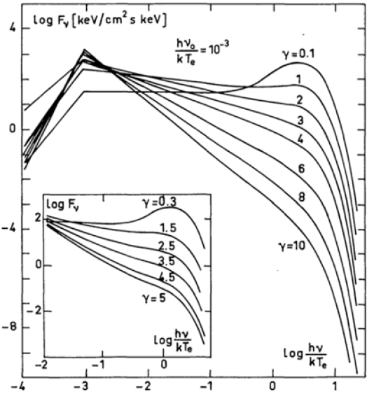
Comptonized spectra for different values of Sunyaev and Titarchuk’s parameter $γ≈y^{−1}$
Wien peak is produced as plasma is Compton thick.
Compton thin but still produces a power law spectrum up to the characteristic thermal frequency ${{kT}_{e}}/h$
Single freq. photon injection $ν_{0}={10}^{−3}⁢{{kT}_{e}}/h$
As long as the injected photons are much cooler than the hot electron scattering plasma, the nature of the output spectrum from Comptonization depends mainly on y, not on the nature of the input spectrum.

